Slide 1
Impact Of High Population In India
Aman Dubey
No need to request edit permission. To make a copy for your presentation, use “File->Download”.

Slide 2
Dataset(s)
Which dataset did you use of the following:
World Development Indicators Dataset

Slide 3
Motivation
To make people aware of the adverse effect of population explosion and the negative effect on the environment.

Slide 4
Research Question(s)
What are the CO2 emission in a highly populated country(like India)?

Slide 5
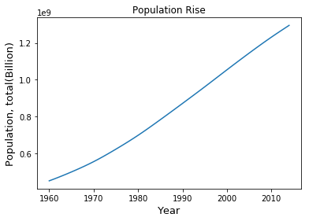
Findings
There is a linear rise in the population of
Country with the time.

Slide 6
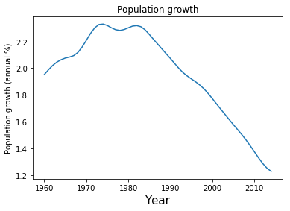
Findings
The population growth rates have shown
a continuous declining trend for both
the sets since around the mid 80s
(due to wide-spread availability and
awareness about the use of various
contraceptive methods).

Slide 7
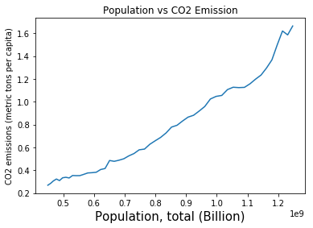
Finding
India was ranked the third-highest carbon
dioxide (CO2) emitter in the world in
2015 after China and USA, according
to the International Energy Agency.

Slide 8
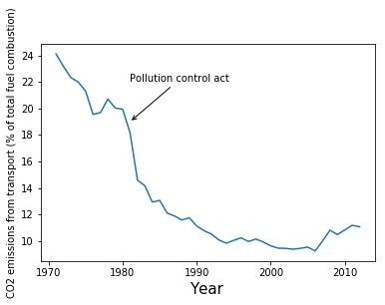
Findings
A decline in emission of CO2 from
transport vehicle after the Pollution
Control Act in 1981.

Slide 9
Conclusion
Countries like India, which is already crippled with huge population, they hold a high rank in CO2 emission countries. This decrease the air quality of the country.

Slide 10
Acknowledgements
I would like to thanks the teacher for their exceptional teaching and my friends for working through this course with me
.

Slide 11
References
Wikipedia

